Slide 1




NEXT GEN EMPLOYABILITY PROGRAM
Creating a future-ready workforce
Team Members
College Name
Student Name :G.Sharmilin Reegha
Student ID :au960221104111
Arunachala College of Engineering for Women

Slide 2

CAPSTONE PROJECT SHOWCASE
Project Title
Car Rentals Application with Django Framework
Abstract | Problem Statement | Project Overview | Proposed Solution | Technology Used | Modelling & Results | Conclusion

Slide 3
Abstract
The abstract for the car rental application using the Django framework encapsulates a cutting-edge solution for individuals looking to rent cars. This innovative platform offers a seamless booking process, secure payment options, and a user-friendly interface for enhanced convenience. By leveraging the Django framework, the application ensures robust functionality, scalability, and efficient development. With a focus on user experience, advanced features, and industry compliance, the car rental application sets out to redefine the rental experience and cater to the evolving needs of customers and rental service providers alike.The frontend interface is designed to be responsive and accessible across various devices, offering a seamless browsing and booking experience.The backend system leverages Django's ORM (Object-Relational Mapping) to interact with the database. The proposed system will streamline the car rental process, enhancing efficiency and customer satisfaction.
Source :

Slide 4
Problem Statement
The car rental industry faces several challenges in terms of efficiency, user experience, and management of resources. There is a need for a Django-based application to streamline booking processes, enhance user experience, and improve resource management in the car rental industry. The people mostly use manual processes to complete their rentals, the process is not as perfect as they would like.
Customers have experienced the following issues:
To rent a car, the owner usually needs to go to the nearest branch to register a new car for rent.
To rent a car, a potential landlord who wishes to rent a car must first go to the nearest branch to register as a client.
Cars that have difficulty renting are often featured in local or national newspapers. It involves voting paperwork and is time consuming.
Source :

Slide 5
Project Overview
The Car Rentals Application, developed with Django framework, revolutionizes the car rental process for customers and administrators alike. Customers benefit from a seamless experience, starting with easy registration and authentication. The intuitive frontend interface allows for effortless browsing of available vehicles and swift booking completion. Integration with secure payment gateways ensures hassle-free transactions, enhancing overall user satisfaction.
Administrators enjoy robust backend management tools facilitated by Django's ORM capabilities. These tools enable efficient inventory management, including adding, updating, and removing vehicle listings. Additionally, the application provides comprehensive reporting features, empowering administrators to track bookings, monitor revenue, and analyze trends for informed decision-making.
The application's architecture prioritizes scalability and performance, ensuring smooth operation even during peak usage periods. Built-in security features of Django provide peace of mind by safeguarding sensitive user data and transactions. Overall, the Car Rentals Application sets a new standard for excellence in the industry, delivering a user-centric, efficient, and secure solution for both customers and administrators
Source :

Slide 6
Proposed Solution
The proposed solution for a Car Rentals Application using the Django Framework aims to provide a comprehensive and user-friendly platform for renting cars. The application will include various features such as user authentication for registration and login, ensuring secure access to the system. Car management with CRUD operations will be available for administrators, which includes adding, editing, and deleting car details. A rental booking system with availability checks and payment processing integration will enable users to select their desired car and make online payments. Moreover, a reviews and ratings feature will allow users to share their experiences and provide valuable feedback.
Integration with a payment gateway will ensure secure transactions. The application will also feature a notification system to send reminders to users about their upcoming bookings. Reporting and analytics will allow administrators to track rental metrics and make informed decisions. To improve visibility and reach, the application will implement SEO and marketing strategies. Social media integration will enable users to share their experiences on various platforms. Overall, this proposed solution combines functionality, security, and customer-centric features to create an efficient and user-friendly car rental application.
Source :

Slide 7
The proposed system takes into account the shortcomings of the current system, as pointed:-
It includes a registration and login portal for customers and administrators.
No information is repeated anywhere in memory. This will ensure economical use of storage space and consistency of stored data.
The accuracy of the proposed system is higher.
This online car rental system helps support office management by streamlining and standardizing procedures.
This saves a lot of time, money and manpower.
Environmentally Friendly: Monitoring vehicle performance and overall activity becomes easy and requires little paper.
The software acts as a 24/7 desktop.
It increases the efficiency of management by providing quality services to clients.
Source :

Slide 8
User Dashboard: Create a dashboard where users can view their rental history, manage bookings, update profile information, and access any other relevant features. This will enhance the user experience and enable users to easily keep track of their bookings and preferences.
Reporting and Analytics: Develop a reporting system that provides insights into rental metrics, such as revenue, popular car models, and customer preferences. Generate reports and visualizations to help the admin make data-driven decisions and optimize the business.
SEO and Marketing: Implement search engine optimization (SEO) best practices to improve the application's visibility on search engines. Utilize marketing techniques such as social media integration, referral programs, and discounts to attract and retain customers.
These are just some proposed solutions and can be customized based on your specific requirements and business model. Django provides a robust framework to build a scalable and feature-rich Car Rentals Application
Source :

Slide 9


Technology Used
Front-end
Back-end
Source :

Slide 10
Modelling & Results
The modeling and results for the Car Rentals Application with Django Framework involve the development and implementation of various key components.
Firstly, a well-designed database schema is crucial for efficiently storing user data, vehicle details, bookings, and transactions. User authentication features are then implemented to ensure secure access to the application. Vehicle listings are modeled with attributes such as make, model, year, and availability, allowing users to browse and search for vehicles seamlessly. Payment integration with secure gateways facilitates online transactions. Administrative tools are developed for managing vehicle listings, user accounts, bookings, and generating reports. Responsive frontend interfaces are designed for user interaction. Backend implementation involves writing views, templates, and controllers to process user requests and generate dynamic content. Testing ensures functionality, and deployment ensures scalability and reliability.
Results are evaluated based on user satisfaction, booking efficiency, system performance, revenue generation, and compliance with regulations, allowing for continuous improvement and optimization of the application.
Source :

Slide 11
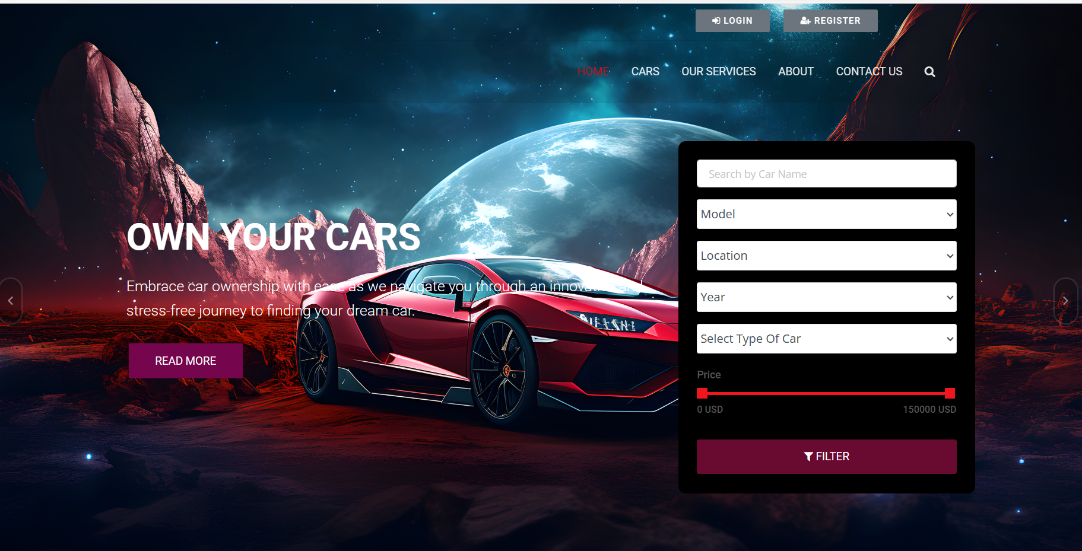
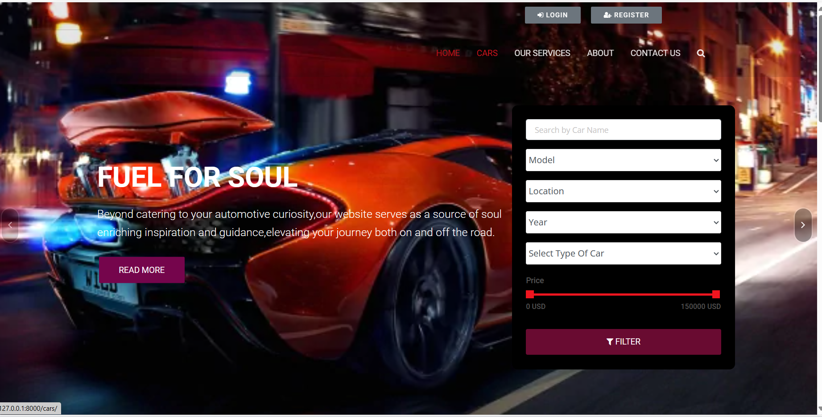
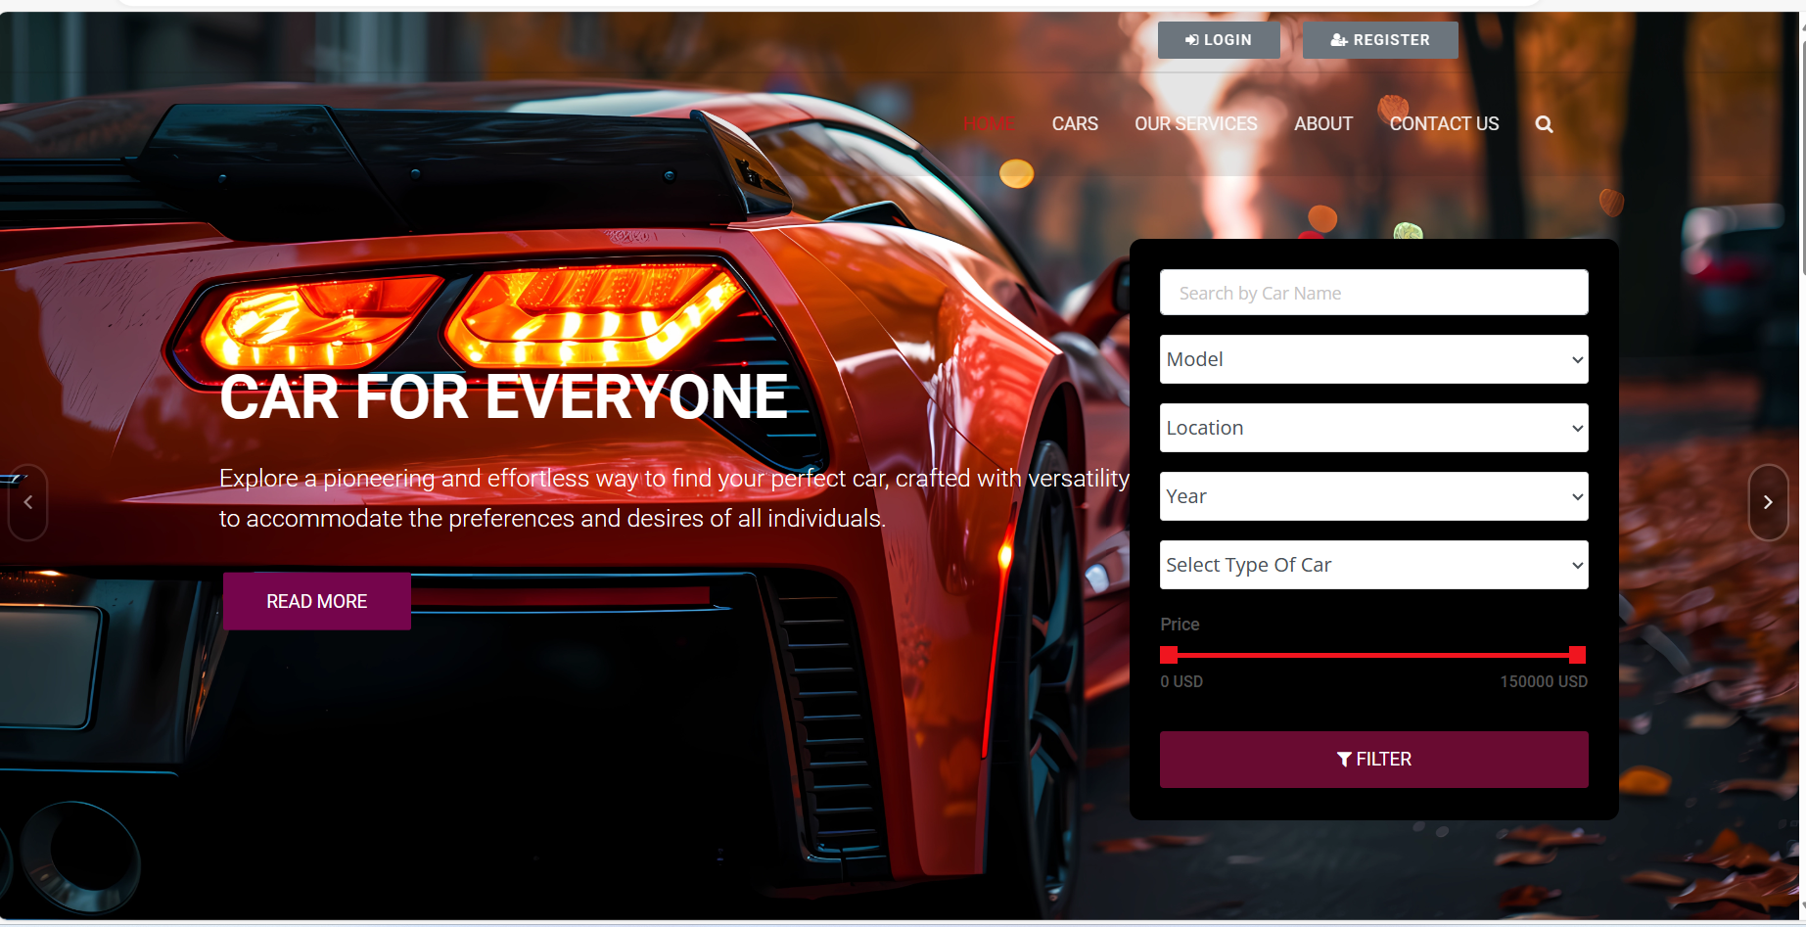
Homepage

Slide 12
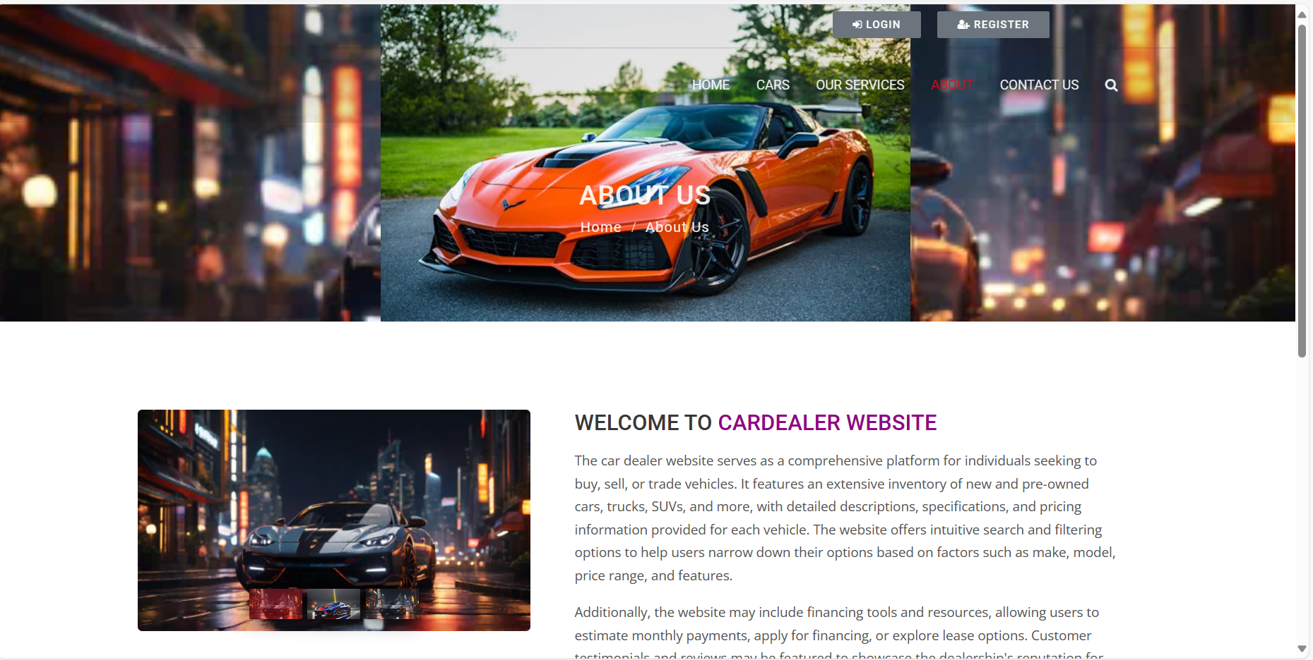
About-Us-Page

Slide 13
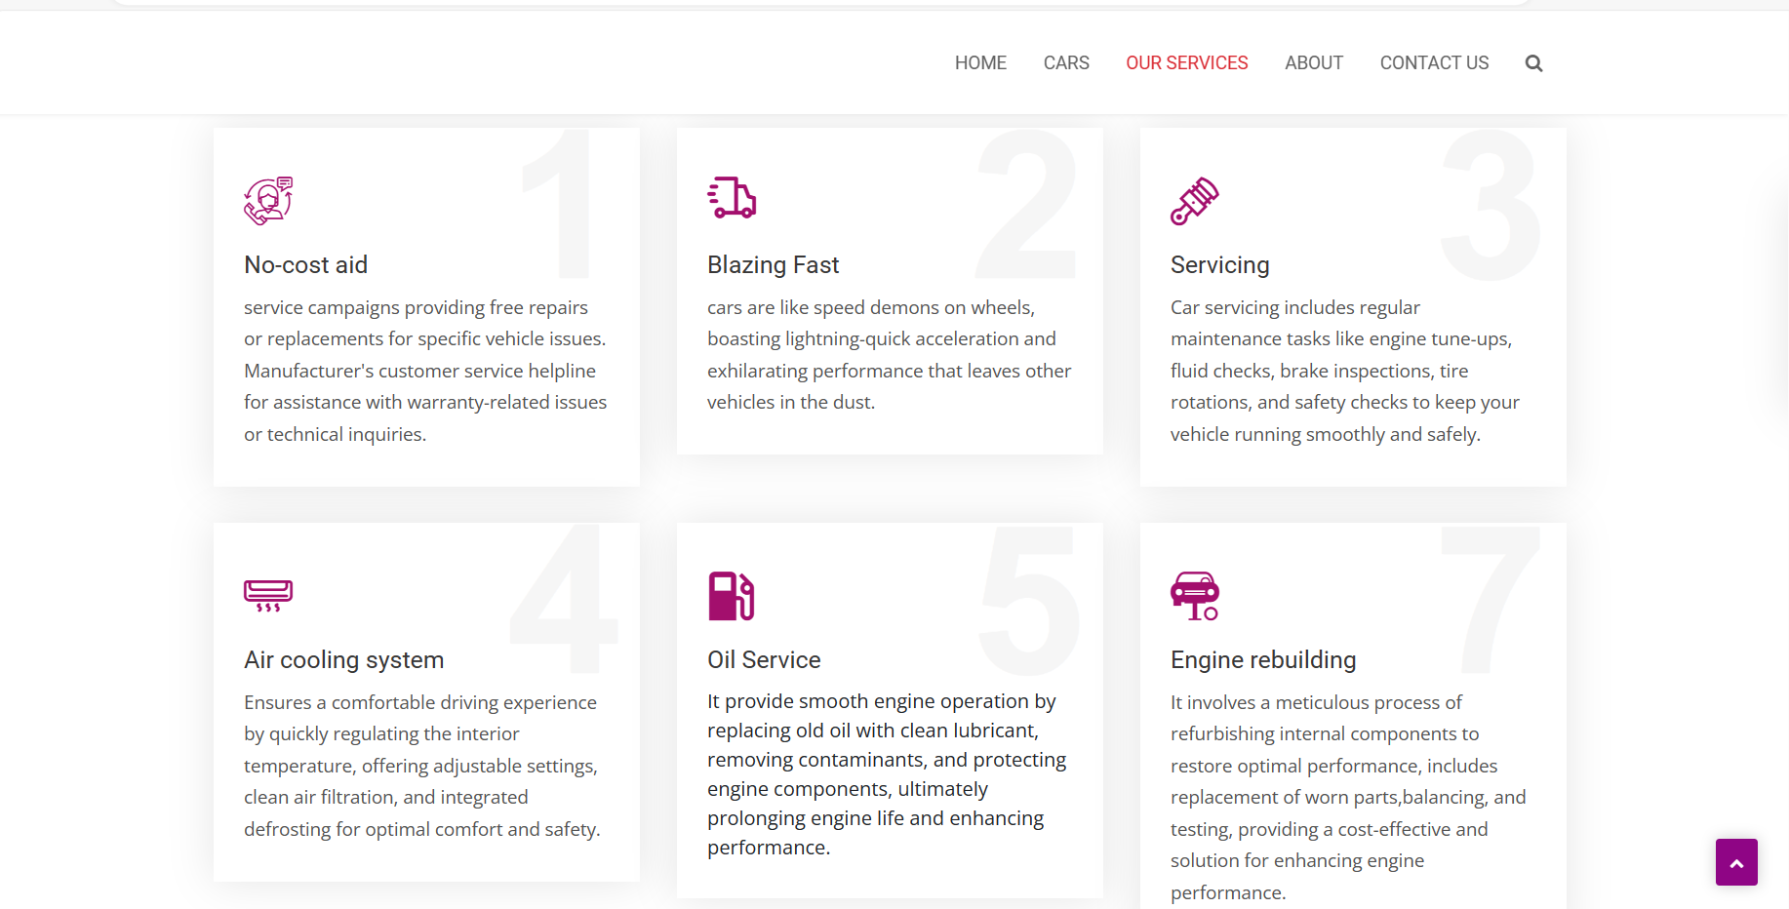
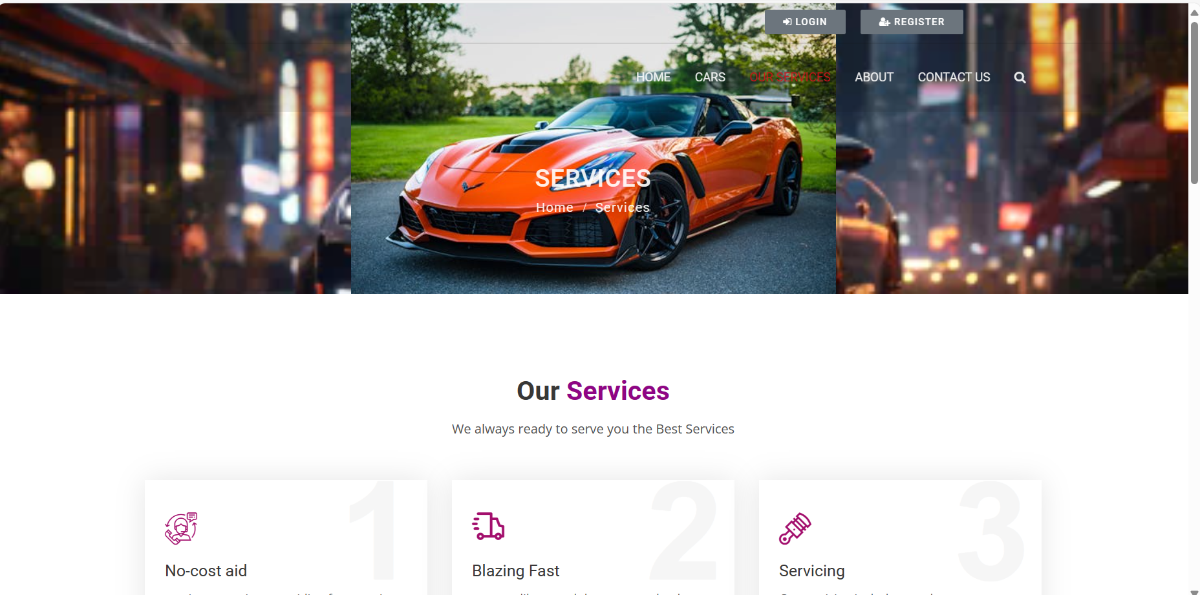
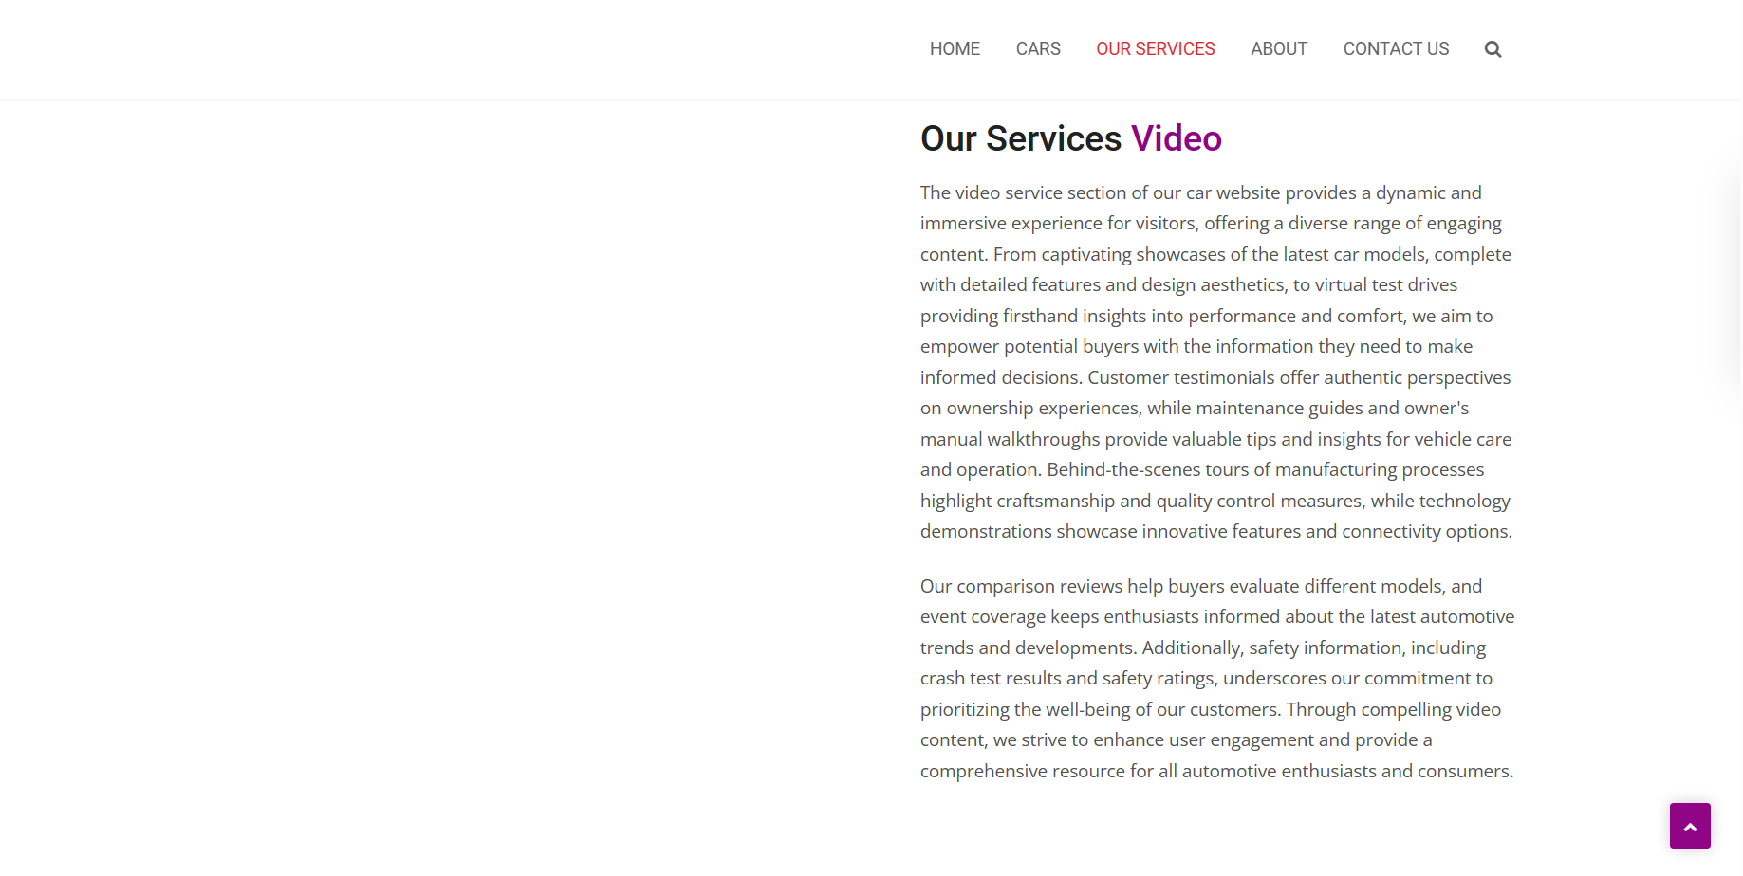
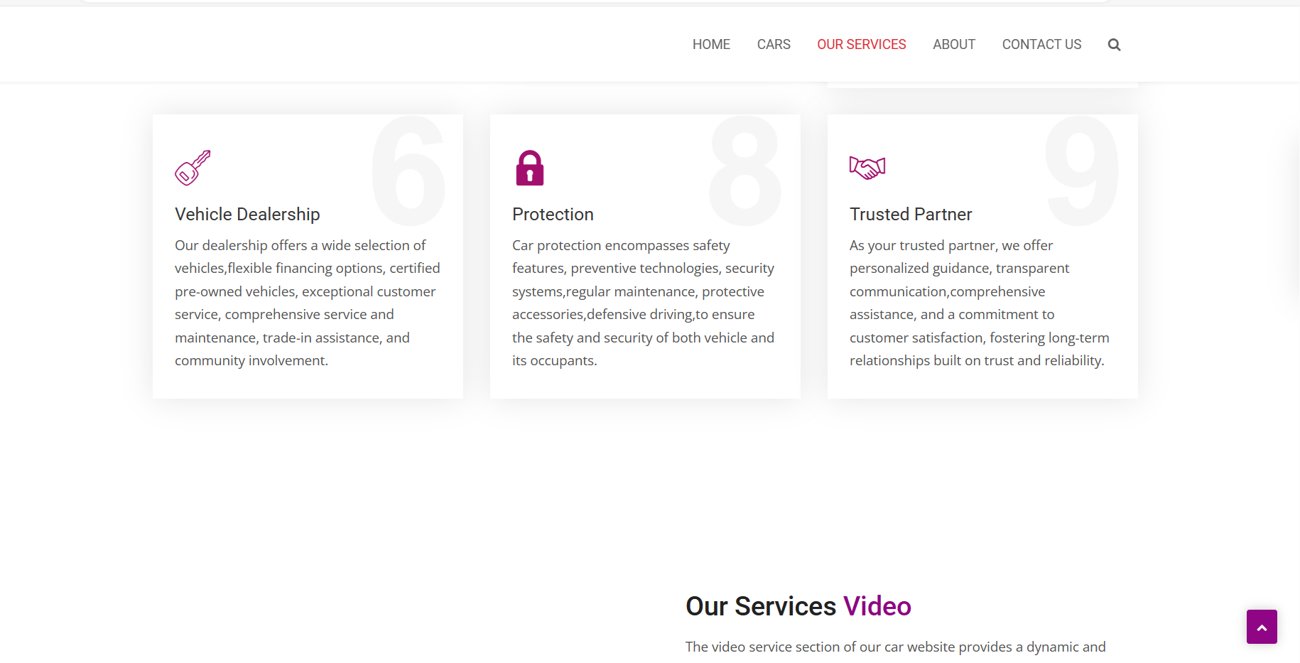
Service-Page

Slide 14
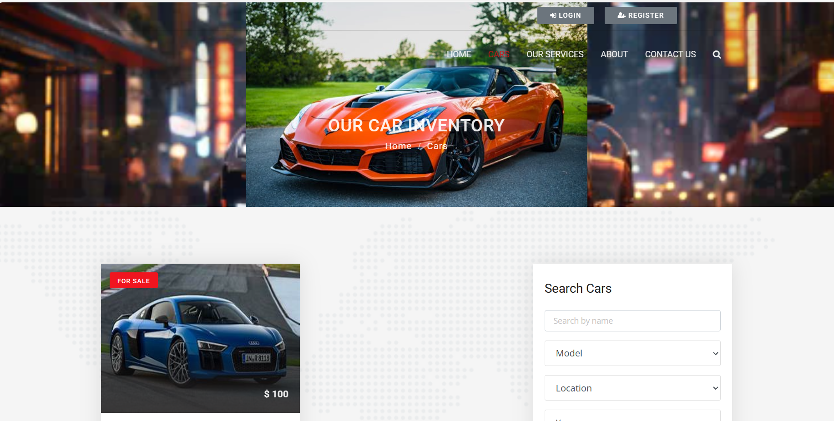
Cars-Page

Slide 15
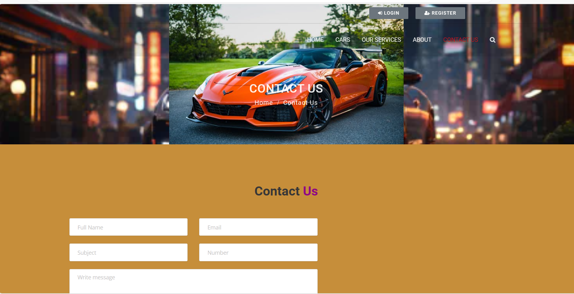
Contact Us-Page

Slide 16
Future Enhancements:
The future of the car rental industry is very exciting and promises significant evolution and growth, mainly fueled by advancements in technology and changing consumer demands. India, with its growing urban population and increasing digital connectivity, presents unique opportunities and challenges for the car rental industry. The changes will be primarily driven by the increased acceptance of vehicle rental and subscription services over ownership, a shift toward environmentally friendly sustainable alternatives, integration of AI, ML and IoT technologies to deliver complete reliability, safety and service.
Environmental Sustainability Initiatives: Introducing eco-friendly vehicle options and promoting carbon offset programs to align with growing consumer preferences for sustainable transportation solutions.
Geolocation Services: Incorporating geolocation features to enable customers to locate rental vehicles easily and efficiently, improving the overall convenience of the rental experience.

Slide 17
Conclusion:
In conclusion, the Car Rentals Application developed with the Django framework represents a significant advancement in the car rental industry. By leveraging Django's robust features, including its scalability, security, and flexibility, the application delivers a seamless experience for both customers and administrators. With intuitive user interfaces, efficient booking processes, and secure payment integration, the application streamlines the rental process and enhances user satisfaction. Administrators benefit from powerful backend tools for inventory management, reporting, and business insights, leading to improved operational efficiency and revenue optimization. Additionally, the application's adherence to industry standards and regulations ensures data privacy and security for all users. Overall, the Car Rentals Application sets a new standard for excellence in the industry, demonstrating the potential of modern technology to transform traditional business models. As the car rental market continues to evolve, the application remains poised to adapt and innovate, providing a user-centric, efficient, and secure solution for the evolving needs of customers and administrators.
Source :

Slide 18
Thank You!
Notes:
Thank You !!

